Slide 1



ANALYSIS OF CUSTOMER DATA WHO ARE CAPABLE OF REPAYING THE LOAN DOMAIN-FINANCE
BDA 105-Spark Project Report
BY
Harshida Jegadeesh Chandar

Slide 2
Introduction
Dataset is provided by a financial bank
Includes telco and transactional information
Focus on deserving population of customers and extend its positive service to them
Data - 37 features and 307,497 rows
Categorical – 9 features
Target – 1 and 0
3 major dimensions- amt_credit, amt_annuity and amt_income_total

Slide 3
Project goal/Object
Predict repayment abilities of customers through analysis based on the target value given in the dataset using Spark so that the loans are not rejected for capable customers

Slide 4
Procedure
Dataset was imported as such into Scala IDE with the help of Spark core techniques
Checked for duplicate values and null values in the dataset using spark core/SQL queries
As it is difficult to read and understand thousands of rows of data and since any kind of analysis involves visualisation the output of the SQL queries was visualized using Pyspark Sparkcontext and session were created in jupyter notebook
The SQL queries were written in jupyter notebook and the resulting output dataset was converted to data frame and then visualised

Slide 5
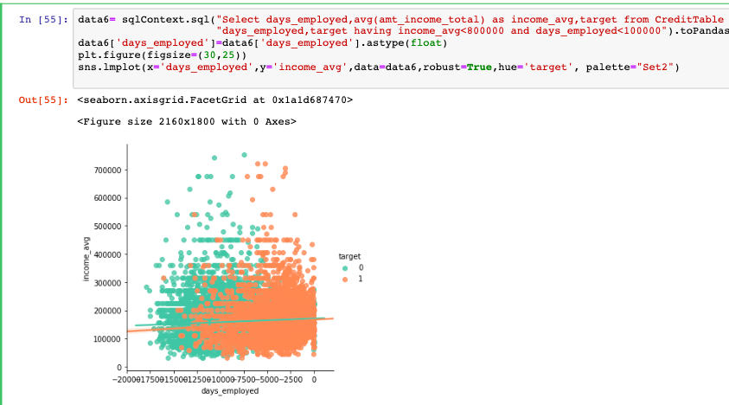

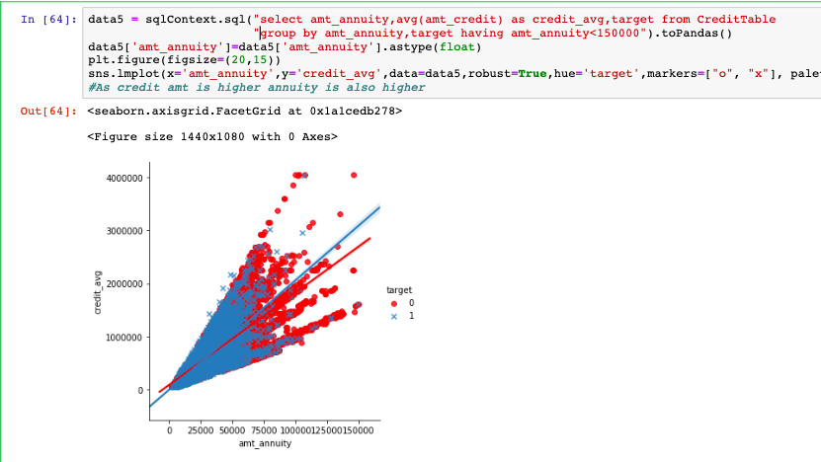
Analysis & Visualizations
Ratio of 1s in the population is just 8%
Compare customer patterns in 1 and 0 to start with the analysis
1st image – income average vs days employed for customers in 0 and 1
2nd image – loan average vs days employed
pattern of customers in 1 and 0 appear similar in both the images which means this cannot be leveraged to differentiate customers capable and incapable of repaying loans

Slide 6
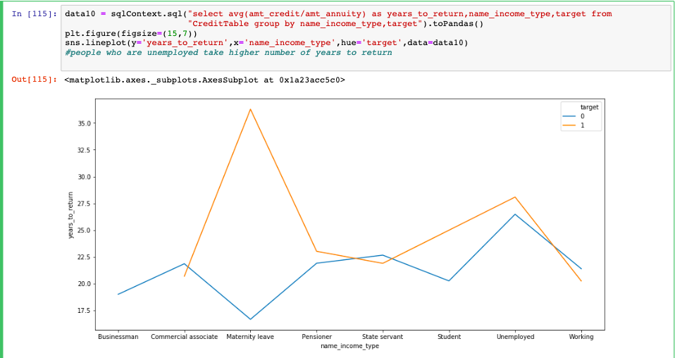
Hence Analysis on the basis of ratios
amt_credit/amt_annuity – years to return
amt_income_total/amt_credit - Ratio>1 (favourable customers)
amt_income_total/amt_annuity –Ratio>1 (favourable customers)

Slide 7
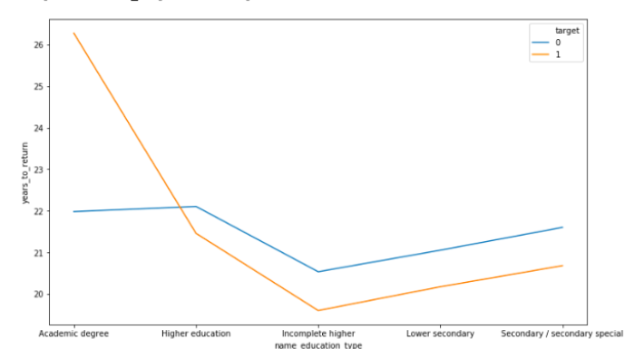
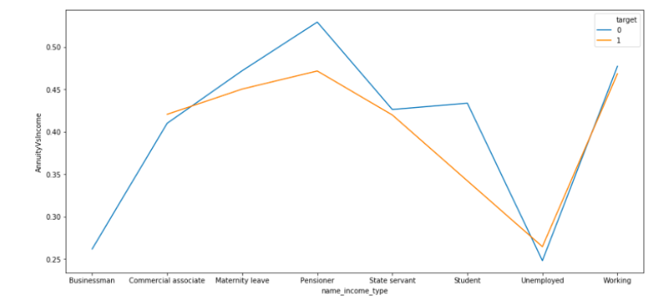
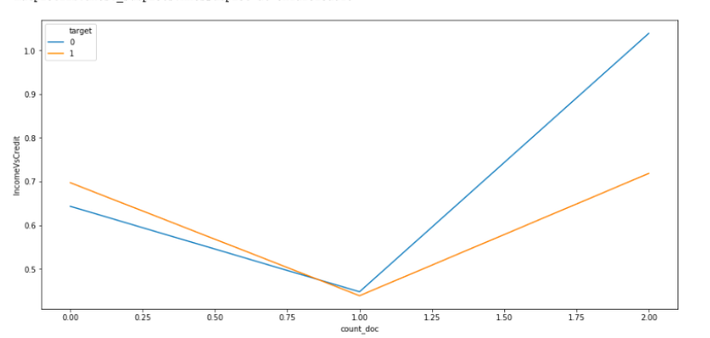
All other Flag_ phone and region columns were checked in the same manner and they did not show any commendable impact in the analysis

Slide 8
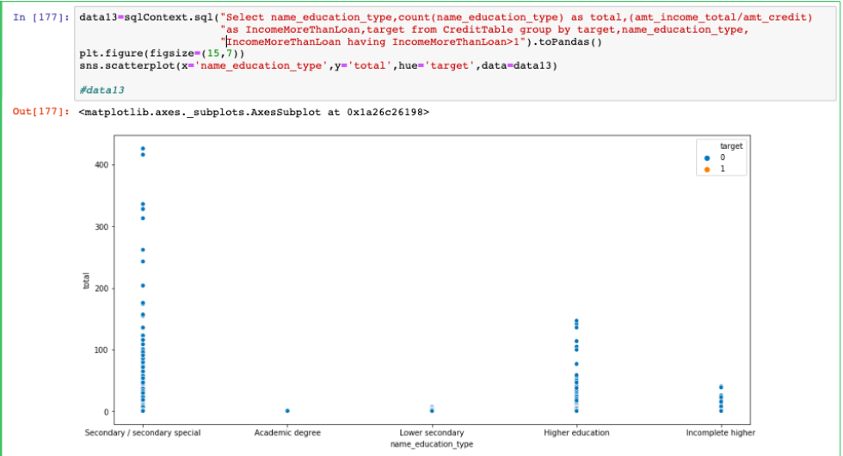
Analysis based on credit vs income ratio

Slide 9
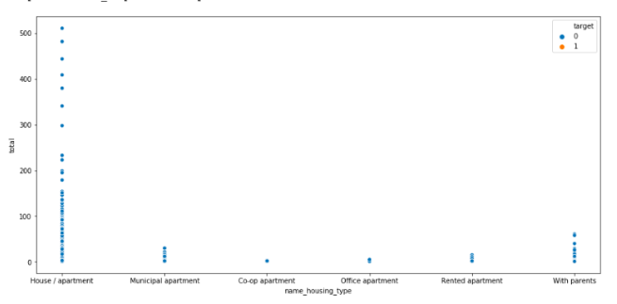
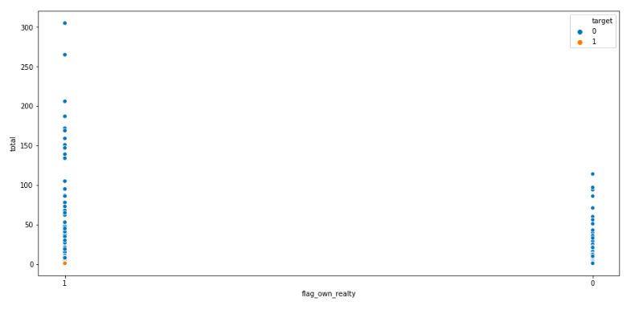
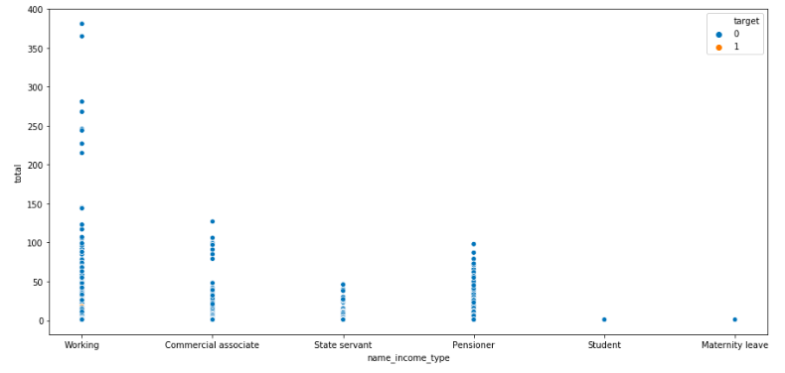

Slide 10
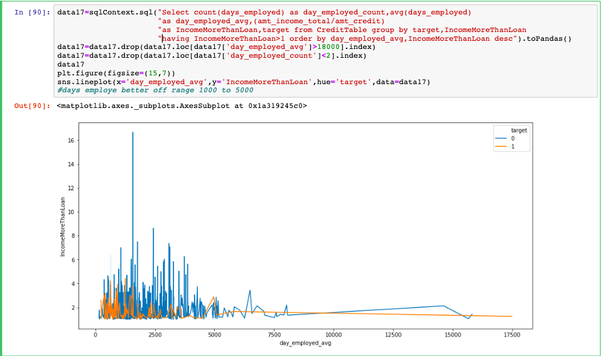
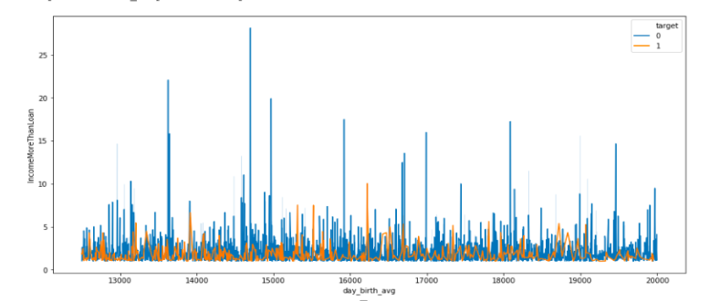
Customers who have been employed from 0 to 5000 have higher income than loan. Stoops down after 7500
Days birth from 12500 to 20000 days(34 – 54 years) are higher in count who are having Income more than credit

Slide 11
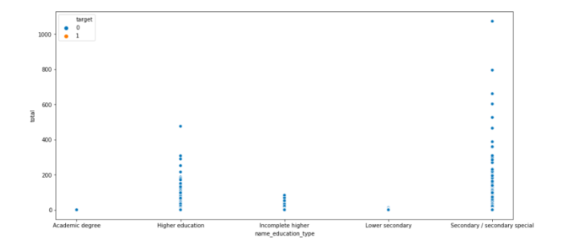
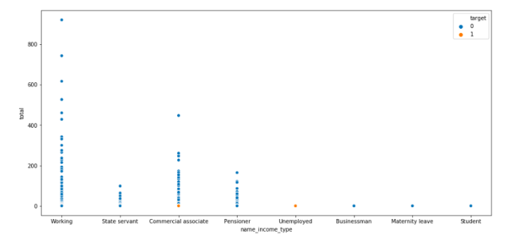
Analysis based on income to annuity ratio

Slide 12
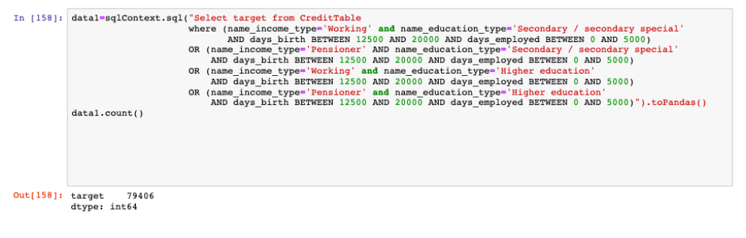
Conclusion
Based on the analysis above the data set was filtered by categories of data that performed better.
This gave an output of 79,406(25.8%) rows which means 79,406 customers are capable of repaying the loan based on their educational qualification, income type, age, days employed.

